Slide 1
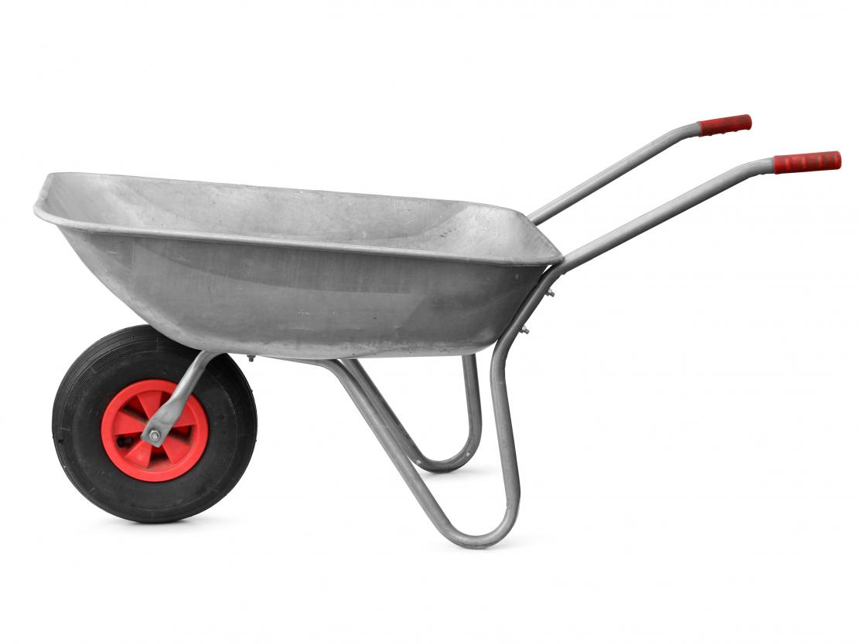
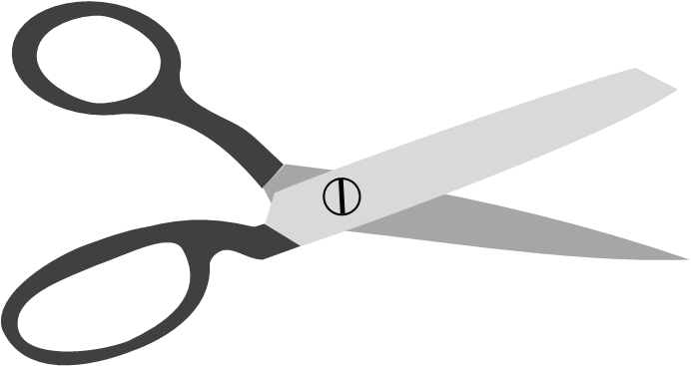
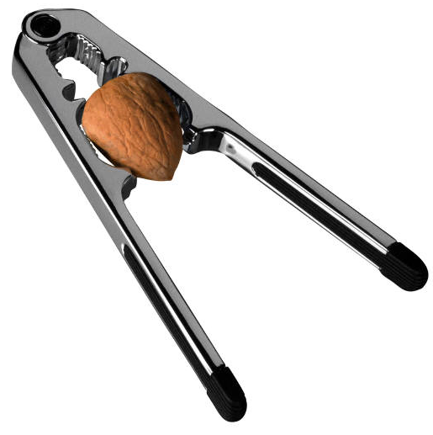
Daily Review
Reminder
FOIL! Class 1: Fulcrum in the middle Class 2: Output force in the middle Class 3: Input force in the middle Levers are easy!
Determine the class of each lever below by labelling the fulcrum, input force and output force.
Input
Output
Fulcrum
Input
Output
Vocabulary
fulcrum (noun) the turning point of a lever input force (noun) the force used to operate a lever output force (noun) the force that a lever creates
Fulcrum
Class 1
Fulcrum
Class 2
Output
Input
Class 2
Notes:
45 s → share → popsticks

Slide 2
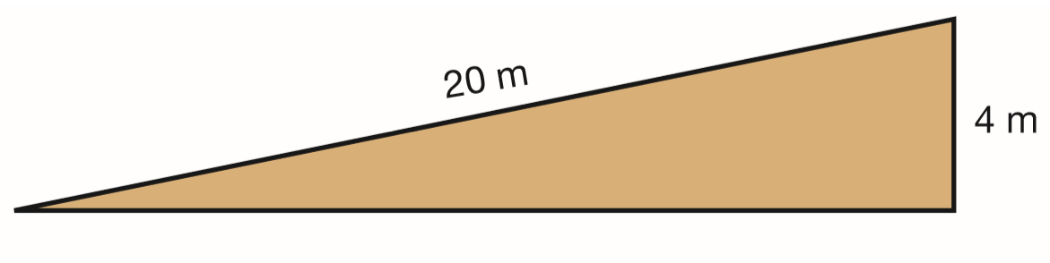
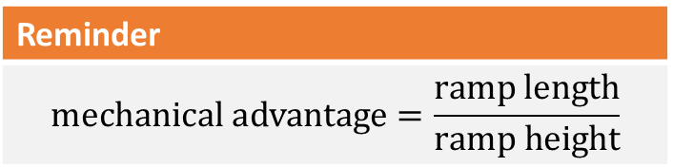

Daily Review
Calculate the mechanical advantage of this ramp. Show your working.
MA = $\frac{15}{3}$
= 5
15 m
3 m
Reminder
$$\text{mechanical} \text{advantage}=\frac{\text{ramp} \text{length}}{\text{ramp} \text{height}}$$

Slide 3
Simple Machines: Screws and Wedges Year 7 Science

Slide 4
Learning Objectives
CFU
What are we going to learn?
Identify different types of inclined planes.
Explain and compare the mechanical advantages of screws and wedges.
Activate Prior Knowledge
Ramps make moving loads easier by making an object travel over a longer distance.
Think, Pair, Share: Which would be easier to move up – a long, gentle ramp or a short, steep ramp? Explain your choice.

Slide 5
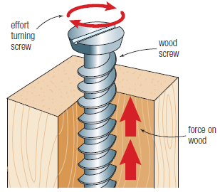
Concept Development
CFU 1
What is a screw?
Screws
A screw is a spiral-shaped inclined plane that is designed to cut into another substance.
As a screwdriver turns a screw into a piece of wood, the timber moves along the spiral ramp.
This requires much less input force than hammering a nail.
However, the screw is moved a greater distance when screwed into place.
CFU 2
How do screws work?
CFU 3
What is an advantage of using a screw?
CFU 4
What is a disadvantage of using a screw?

Slide 6
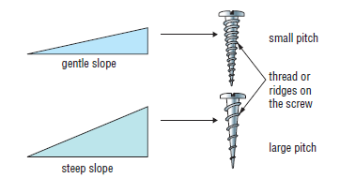
Concept Development
CFU 1
What is the thread of a screw?
Screws
The spiral inclined plane around a screw is called the thread.
The distance between the threads on a screw is called the pitch.
closer thread = smaller pitch = less input force required
CFU 2
What is the pitch of a screw?
CFU 3
How does the thread affect the pitch of the screw?
CFU 4
How does the pitch affect the use of the screw?
Vocabulary
screw (noun) spiral-shaped inclined plane that cuts into another substance

Slide 7
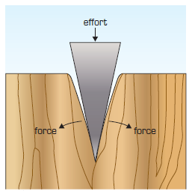
Concept Development
CFU 1
What is a wedge?
Wedges
A wedge is a double inclined plane that moves through another object.
Knives, axes, pins, and doorstops are all examples of wedges.
Wedges are used to split objects because they change the direction of a force by ~90° and increase its size.
When an axe is pushed downwards, the wedge of the axe head pushes the wood apart.
CFU 2
Think, Pair, Share: why are wedges described as double inclined planes?
CFU 3
What do wedges do to their input forces?

Slide 8
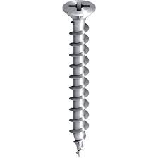
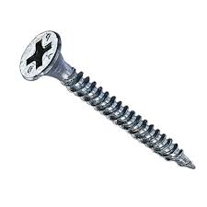
Skill Development / Guided Practice
Which screw will require less input force to use? Explain your choice. (Assume the screws are the same size.)
Comparing Screws
closer thread = smaller pitch = less input force required
The screw on the right will require less input force because its thread is closer or because its pitch is smaller.

Slide 9
Skill Development / Guided Practice
Which wedge will require less input force to use? Explain your choice.
Comparing Wedges
steeper slope = sharper wedge = less input force required (The trade-off is that a narrow wedge moves things a smaller distance.)
The wedge on the left will require less input force because it has a steeper slope.

Slide 10
Skill Development / Guided Practice
Which wedge will require less effort to use? Explain your choice.
Comparing Wedges
steeper slope = sharper wedge = less input force required
The wedge on the right will require less input force because it has a steeper slope.

Slide 11
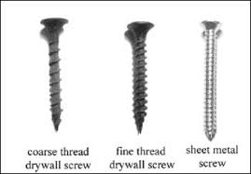
Skill Development / Guided Practice
Which screw will require less effort to use? Explain your choice. (Assume the screws are the same size)
Comparing Screws
closer thread = smaller pitch = less input force required
The screw on the left will require less input force because its thread is closer or because its pitch is smaller.

Slide 12
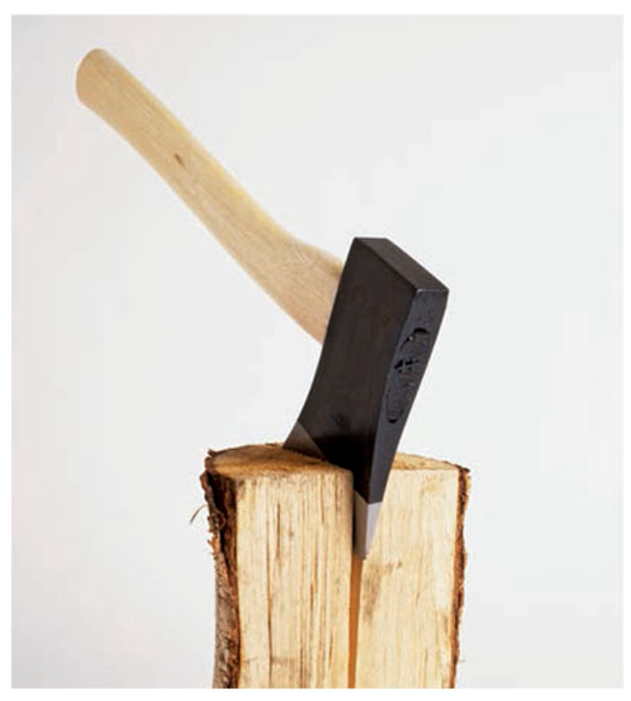
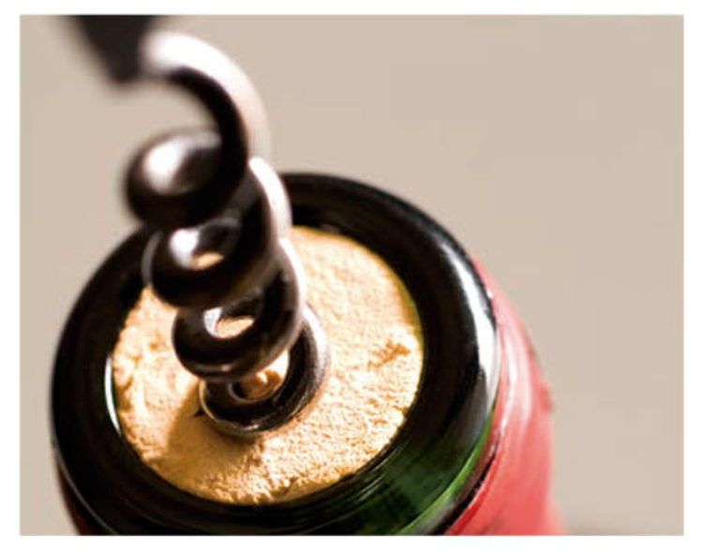
Relevance
As you’ve already seen, different types of inclined planes are used a lot in everyday life.
Knowing how to use wedges and screws can make your life much easier!

Slide 13
Skill Closure
Which one of the following is not an inclined plane?
using a knife to cut cheese
twisting a screw into a piece of wood
winding up a fishing reel
an axe chopping wood
Wedges are ________ inclined planes that are used to split objects by __________ the direction of a force by ______° and increasing / decreasing its size.
Which wedge will require the least input force to use? Explain your choice.

Slide 14
Independent Practice
List three common examples of wedges.
State which simple machine could be called:
a double inclined plane, and explain why
a spiral inclined plane, and explain why
State whether each of these statements is true or false. If they are false, correct them.
the longer the slope of a ramp for a certain height, the greater its mechanical advantage.
a screw with a small pitch has a steep inclined plane.
a screw with a small pitch requires fewer turns to be inserted into a piece of wood than a screw with a large pitch.
a wedge changes the direction of a force by ~90° and increases its size.

